Slide 1

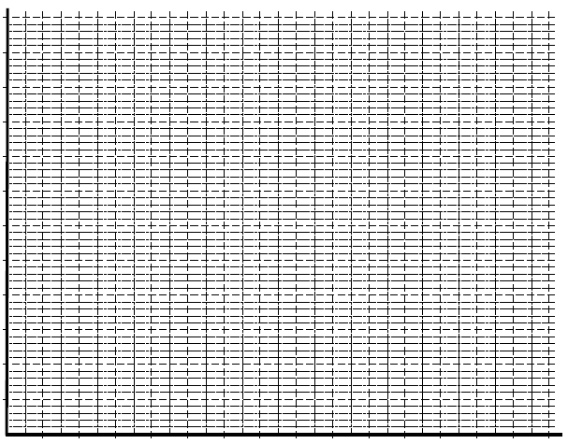
1. Water is leaking from a tank. The volume of water in the tank after 1 hour is 100 L and after 5 hours the volume is 20 L. Assuming the relationship is linear;
Fill in the table
Graph the rule
State the gradient
Write the rule
Finally state the initial volume of water in the tank (at time =0)
Time
Litres

Slide 2
2. Steve is a plumber and charges a call out fee of $75 ($75 at time zero) then $50 for every hour he is working on a job.
Fill in the table
Graph the rule
State the gradient
Write the rule
e) Finally find the cost for 3.5 hours of work.
Time
Cost

Slide 3
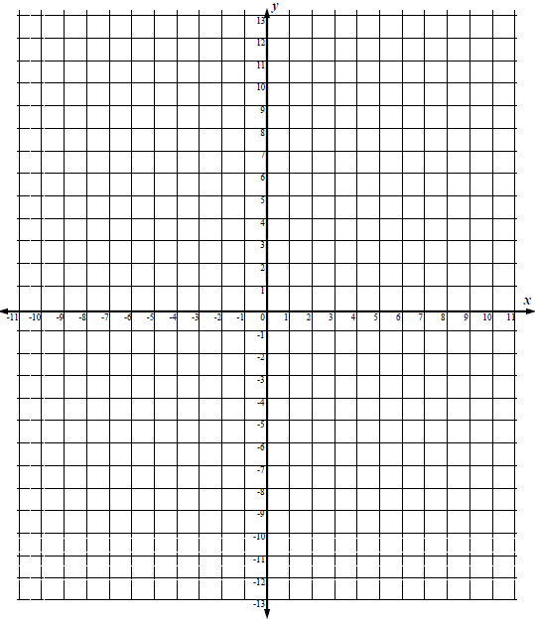
3. The cost of manufacturing a new star wars figurine is $10,000 (for design and production of the plastic mould). The company then makes $2000 in profit for every box of figures (1000 in each box). Consider the cost a negative number (-$10,000) and the profit a positive number.
Fill in the table
Graph the rule
State the gradient
Write the rule
e) How many figurines need to be sold for the company to make back the $10,000.
Boxes
Profit
Key – the y axis goes up in 1000’s (eg 1 = $1000, 2=$2000

Slide 4
4. Michelle has borrowed $7,000 from her mum to buy a new car. If she is paying this back at a rate of $1000 per month
Fill in the table
Graph the rule
State the gradient
Write the rule
How long will it be until she has paid back half the amount
Months
Amount
Key – the y axis goes up in 1000’s (eg 1 = $1000, 2=$2000

